Slide 1

Lecture
Meaning, Scope and nature of financial statements

Slide 2
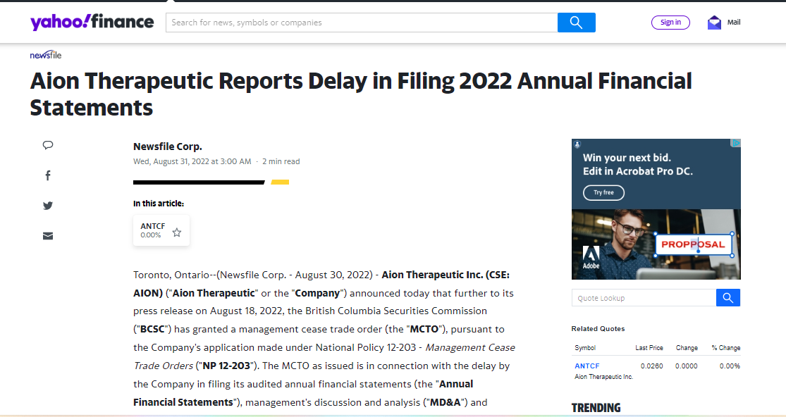

Slide 3
Learning Outcome
Understand the meaning, scope and nature of financial statements.
Analysis of the advantages and disadvantages of financial statements.

Slide 4

Financial Statements?
It is a collection of data organised according to logical and consistent accounting procedures.

Slide 5
Financial statements?
The summarized results of your business financial transactions over a designated period of time.
They will show total income, expenses, cash balances, level of debt, and much more.
But where does this information come from?

Slide 6

Financial Year
As per section 2(41) every company is required to follow a uniform financial year, which commences from 1st April and ends on 31st march every year.

Slide 7
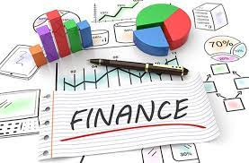

Who is Finance Manager?

Slide 8
Accounts- A Glance
Accounts are the categories into which the effects of transactions are recorded, and from which financial reports are created.
5 major account categories:
Income
Proceeds from sales
Expenses
Costs of operation
Assets
What you own
Liabilities
What you owe
Equity
Net worth / level of investment
Operations
Financial Position
Notes:
The Income and Expense accounts measure business operations – what’s going in and out of the business.
The Assets, Liabilities, and Equity accounts measure financial position.

Slide 9
Chart of Accounts
Sample Income accounts Sales revenue Other income | Sample Expense accounts Rent Cost of Goods Sold (COGS) Marketing Office supplies Payroll Professional fees
Sample Asset accounts Current assets Cash Inventory Accounts receivable Fixed assets Equipment Property | Sample Liability accounts Accounts payable Credit card payable Loan payable | Sample Equity accounts Owner’s equity Retained earnings
Notes:
Within each major account category, you’ll have sub-accounts to further classify your transactions by type of account. Here are some examples of common sub-accounts. Every business will use different account categories, though businesses in the same industry will likely have the same. Your master list of what accounts (categories) you use is called your chart of accounts. Keep it simple, though – you don’t want a million accounts – just the main ones.
Like bank accounts, each of these accounts will have transactions posted to it and will maintain a running balance that is the sum of all the transactions that have been posted to them.
Explain what kind of other income a company might have besides revenue.
Define COGS and why it may be indicated separately from other type of expenses (but that we are not getting into inventory accounting today)
Explain the difference between current and fixed assets
Define accounts receivable and accounts payable.
Define retained earnings as the cumulative net profit of the business.

Slide 10
Scope
Records Financial Transactions Summarize Information Interprets Financial Information Communicates All Outcomes Determines Financial Position

Slide 11
Nature of Financial Statements
Nature of Financial Statements
Accounting Conventions
Personal Judgements
Assumptions
Recorded Facts

Slide 12
Characteristics
Brief
Comparability
Relevance
Attractive
Promptness
Analytical representation

Slide 13

Objectives
Basis for preparation of general financial statements
Ensure comparability
Guidelines for structure
Minimum requirements of the contents
Ensures compliances

Slide 14


Advantages of Financial Statements
Maintain business record
Present true financial position
Prevention and detection of fraud

Slide 15

Acts as legal evidence

Slide 16
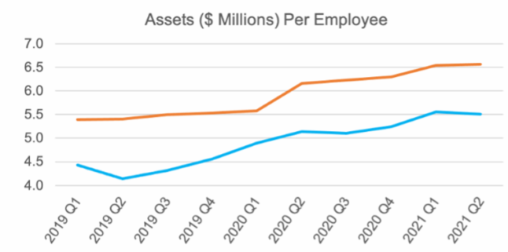
Comparison of results
Assists the management
in decision making

Slide 17
Limitations of financial statements
Financial statements are derived from Historical Costs
Financial statements are Not Adjusted for Inflation
Financial statements are based on Personal Judgments
Financial statements are be Wrong Due to Fraud
Financial statements are do not cover Non-Financial Issues
Financial statements have no Predictive Value

Slide 18
MCQ
Which of the following is true about financial statements? A) Financial statement gives a summary of accounts. B) Financial statements can be stated as recorded facts. a) Only A b) Only B c) Both A and B d) None of the above

Slide 19
MCQ
Which of the following is true about financial statements? A) Financial statement gives a summary of accounts. B) Financial statements can be stated as recorded facts. a) Only A b) Only B c) Both A and B d) None of the above

Slide 20
MCQ
Financial statements are composed of data which are a result of the composition of _________?
Recorded facts concerning the business transactions
Accounting conventions adopted to facilitate the accounting technique
Transactions done on the basis of non monetary basis
Both A and B

Slide 21
MCQ
Financial statements are composed of data which are a result of the composition of _________?
Recorded facts concerning the business transactions
Accounting conventions adopted to facilitate the accounting technique
Transactions done on the basis of non monetary basis
Both A and B

Slide 22
VARIOUS STAKEHOLDERS AND THEIR INTERESTS
Promoters Shareholders other than promoters Prospective investors, such as individuals, corporate Bodies, foreign institutional investors, mutual funds and strategic capital partners Lenders, such as financial institutions, banks and public Creditors | Customers Employees Government and regulatory bodies Public at large Management Researchers and analysts

Slide 23
TOOL KIT OF THE FINANCIAL ANALYST
The profession of accounting and finance has developed a number of tools and techniques aimed at carrying financial statement analysis. These are:
1. Horizontal analysis
2. Common-sized analysis
3. Trend analysis
4. Ratio analysis
5. Cash flow analysis

Slide 24
Horizontal Analysis Example
The management of HUL Company provides you with comparative balance sheets of the years ended March 31, 2020 and 2019. Management asks you to prepare a horizontal analysis on the information.

Slide 25
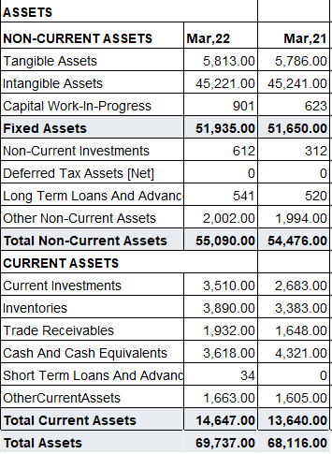
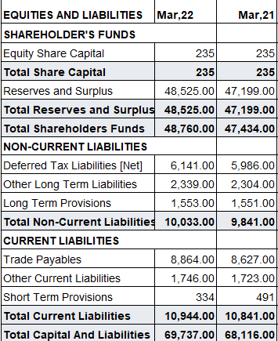

Slide 26

Horizontal Analysis Example
Calculating Change in INR Amounts
INR
Change
Current Year
Figure
Base Year
Figure
=
–

Slide 27
Horizontal Analysis Example
Calculating Change in INR Amounts
Rupee
Change
Current Year
Figure
Base Year
Figure
=
–
Since we are measuring the amount of the change between 2022 and 2021, the Rupee amounts for 2021 become the “base” year figures.

Slide 28
Horizontal Analysis Example
Calculating Change as a Percentage
Percentage
Change
Change
Base Year Figure
×
=
100%

Slide 29
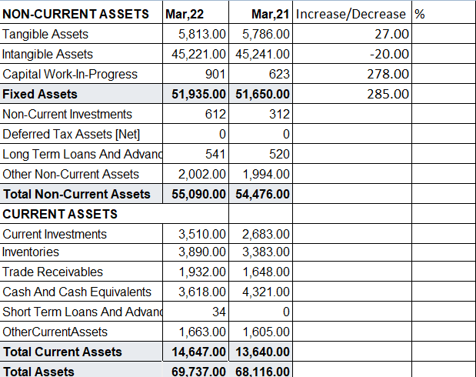
Horizontal Analysis Example
Rs. 51935- Rs. 51650 = Rs. 285

Slide 30
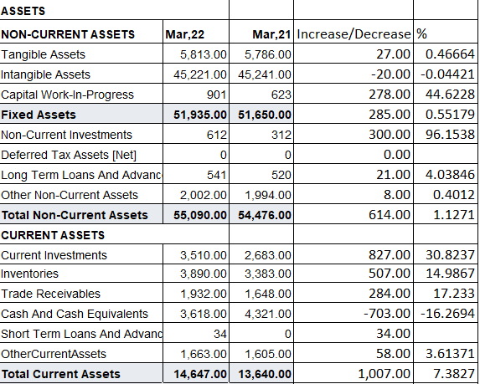
Horizontal Analysis Example
(Rs. 285÷ Rs. 51650)× 100 = 0.55%

Slide 31
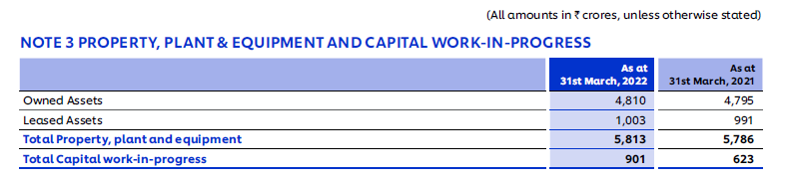
Interpretations
Increase in FA by 0.55%---implies increase in production capacity of HUL. The Company has almost 44% increase in capital work in progress. Hence, HUL is on way of expansion.
Note- Screenshot of PPE as Proof

Slide 32
Horizontal Analysis Example
Non Current Investments
2. Increase in Non current Investments by 96%- Implies investments are purchased and the funds are invested in its Subsidiary company’s Equity. The company want to control its Sister organization.
Total Non Current Assets increase by 1.12 % on overall basis depicts that the company may have some idle funds and they are invested outside.
Increase in Long term Loans and advances by 4.03%---Implies HUL has lent more credit.

Slide 33
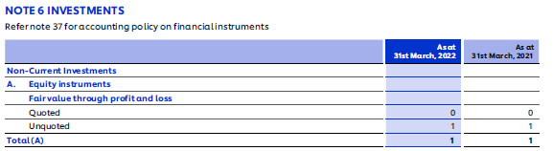
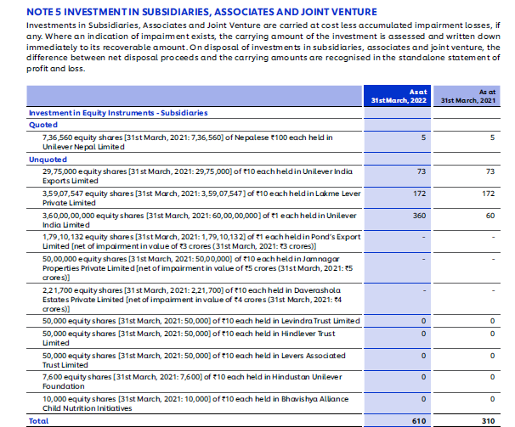
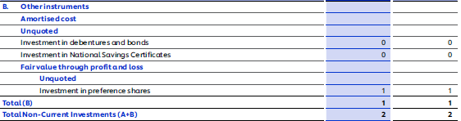
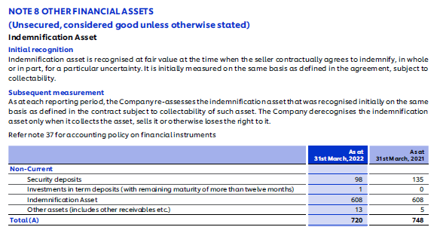

Slide 34
Horizontal Analysis Example
Interpretations
3. Increase in CA by 7.38%---

Slide 35
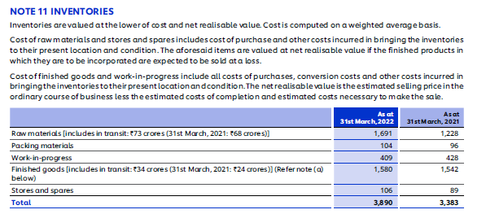
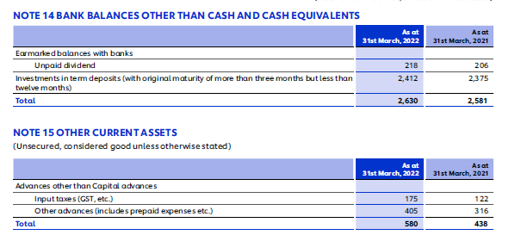

3. Increase in CA by 7.38%---Inspite of reduction in cash by 16%, overall it implies improvement in liquidity position, .
Increase in Investments by 30%- Implies the company would have idle cash sources and it is invested in short term investments

Slide 36
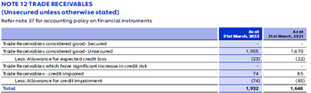
Increase in Stock by 14.9%-- HUL is on the way to increase its production, so there is increase in purchase of raw material. But, increase in stock by 14.9% implies inventory is piled up.
Increase in Trade receivables by 17%--More credit sales, Liberal credit policy, Chance of bad debts are there.

Slide 37
Horizontal Analysis Example
Let’s apply the same
procedures to the
liability and stockholders’
equity sections of the
balance sheet.

Slide 38
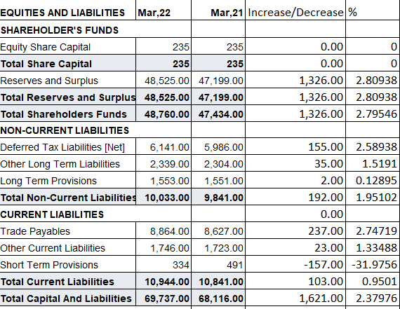
Interpretations
Increase in Reserve & Surplus by 2.80% and increase in overall shareholder’s funds by 2.79%

Slide 39
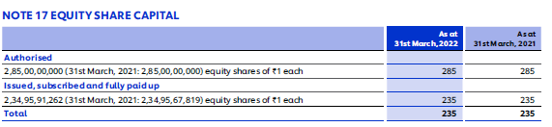
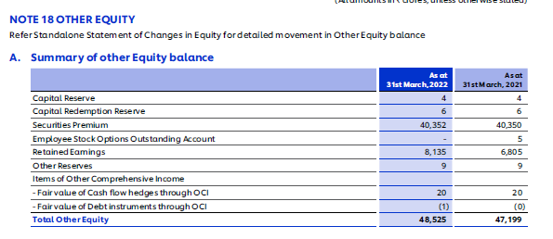
Interpretations
Increase in R &S by 2.80%--implies ploughing back of profits, improves operational efficiency.
Overall Increase in Shareholder’s funds by 2.79%--implies owners contribution in business has been gone up.

Slide 40
Interpretations
3. Increase in Non-CL (Outsider’s funds) by 1.95%
& Increase in CL by 0.95%

Slide 41
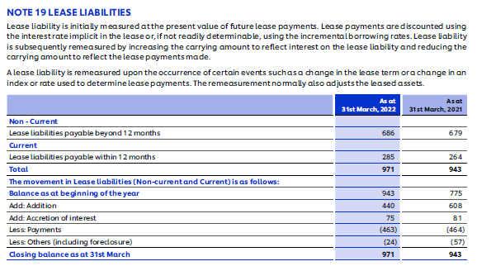
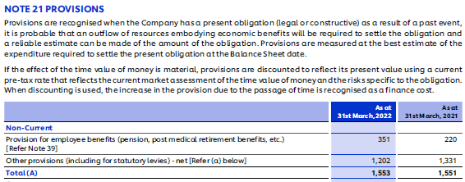
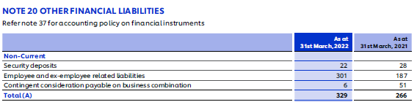
3. Increase in Non-CL (Outsider’s funds) by 1.95%--Implies increase in financial risk due to increase in interest payment obligations, outsiders’ claim on business got increased, may be HUL is on its way of expansion or undertaking strategic changes.

Slide 42
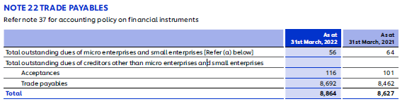
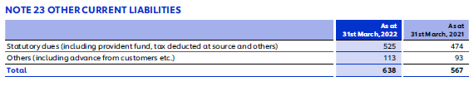
4. Increase in payables by 0.95%--implies more credit period taken from creditors, may affect the liquidity position of HUL.

Slide 43
Questions/Interpretations
Which financial elements of Balance Sheet will be considered to comment on HUL Working Capital Management or Liquidity Management of Company?
CA, FA
CL, CA
CA, Non-CL
Non-CA, Non-CL
Notes:
b

Slide 44
Solution
Current Assets and Current Liabilities
CA in 2022 have been increased by 7.38%, however CL in 2022 has been increased by 0.95%. The percentage increase in CL is lesser than increase in CA. It may have positive impact on HUL’s Working capital Management or Liquidity position i.e. the ability of company to pay its short term liabilities.
If individual amounts of CA and CL of both years are considered then definitely CA are still above than CL, that establishes strong Liquidity position of HUL.

Slide 45
Questions/Interpretations
Which financial elements of Balance Sheet will be considered to comment on HUL Solvency position?
CA, CL
FA, Non-CL
CA, FA
Non-CA, CL
Notes:
b

Slide 46
Solution
Non current Liabilities and Non Current Assets
The percentage increase in Non Current Assets in 2022 relative to 2021 is 1.12% that is less than percentage increase in Non Current Liabilities that is 1.95%. It may give negative impact on Solvency position of HUL.
However, if Rupee change is considered than Non current Assets (Rs. 614 cr ) have been increased almost three times than increase in Non Current Liabilities (Rs. 192 cr.), hence implying that the Solvency position of HUL is strong enough.

Slide 47

Question/Interpretation
Which financial elements will be considered to comment on Financing policy of HUL?

Slide 48


Solution
CA, CL, Non CA and Non CL
An ideal Financing policy is “A company should finance its all non current assets through non current liabilities and all current assets should be financed from current liabilities”.
Non current assets should never get financed by raising current liabilities. However, part of current assets can get financed through Non-current liabilities.

Slide 49
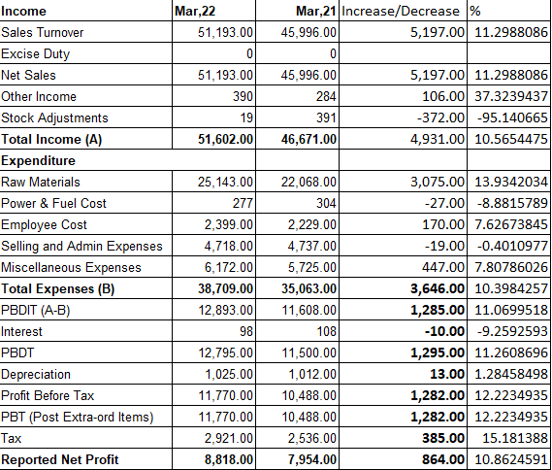
Comparative Income statement

Slide 50
Interpretations
Increase in Revenue by 10.56%
Increase in total EXP. by 10.39%
Increase in Depreciation
by 1.28%
4. Increase in NP by 10.86%

Slide 51
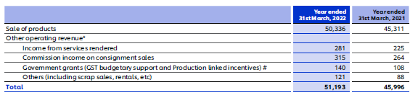
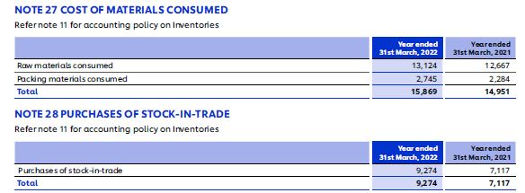
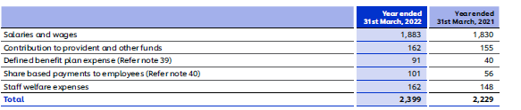
The revenue has been increased by 10.56%, Expenditure Increased by 10.39%, Net Profit(PAT) have been increased by 10.86%. It shows efficiency control that despite increase in exp. the company is able to maintain its profitability increase by 10.86%.

Slide 52
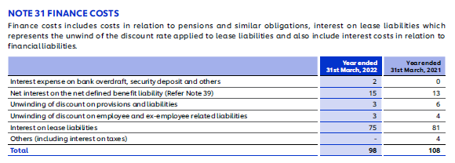

Interest or Finance Cost decreased by 9.25%, implying decrease in interest on lease liabilities. It states that the fixed obligations in the form of interest payment are reducing.
Depreciation is increased by 1.3% implying purchase of more FA in 2022.

Slide 53
Debtors/Receivable Management
The revenue has been increased by 10.56%, however the trade receivables have been increased 17.23%. It implies that there was more credit sales in 2022 and HUL has liberal Receivable management. One drawback of liberal credit policy it may result in bad debts.

Slide 54
Management of Creditors/ Trade Payable
Raw materials have been increased by 13.93%% implies the company would have purchased raw materials for more production, however Trade payables have just risen up by 2.74% in 2022, implying Company cash purchases are increasing subsequently in 2022 in comparison to credit purchases.

Slide 55
Fixed Asset Utilization
Rs. in Cr.
Increase in FA by 0.55% and on other side, Revenue from operations also increased by 10.56%---Implies FA utilization has been improved. It gives further scope to HUL for taking best utilization of its investment in FA.

Slide 56
Inventory Management
Rs. in Cr.
The increase in inventory is 14.98% is much higher than increase in Sales, implying less efficient Inventory management. The inventory has been piled up.

Slide 57
Financial Risk
Long term debt has been increased by 1.95%, even short term debt has been risen up by 0.95%. On other side, the shareholder’s funds has been increased by just 2.75% that is due to equivalent increase in surplus.
However, if individual amounts are considered then Shareholders funds is too high as comparative to Non current Liabilities thus provides safe window for lenders to provide credit to HUL.

Slide 58
Vertical Analysis
It is a method of financial statement analysis in which each line item is listed as a percentage of a base figure within the statement.

Slide 59
Cont..
The most common use of vertical analysis is within a financial statement for a single reporting period, so that one can see the relative proportions of account balances.
Vertical analysis can become a more potent tool when used in conjunction with horizontal analysis, which considers the finances of a certain period of time such as on a comparative basis over a five-year period.
For example, if the cost of goods sold has a history of being 40% of sales in each of the past four years, then a new percentage of 48% would be a cause for alarm.

Slide 60
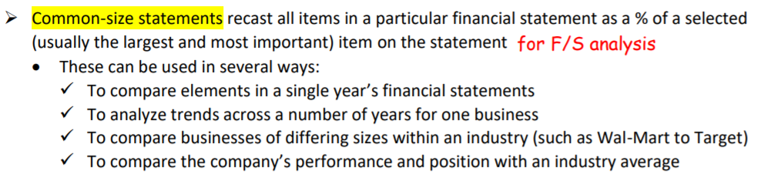
Common Size Statements

Slide 61
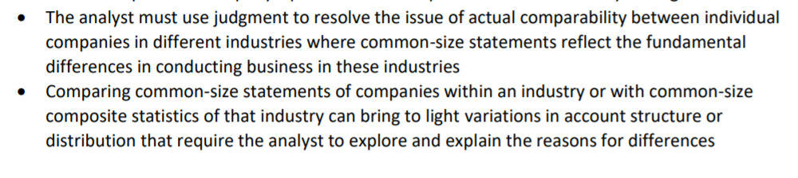
Cont..

Slide 62
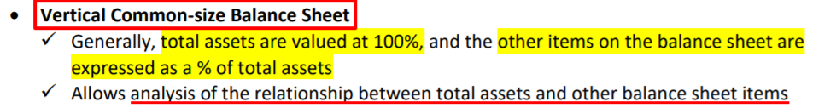
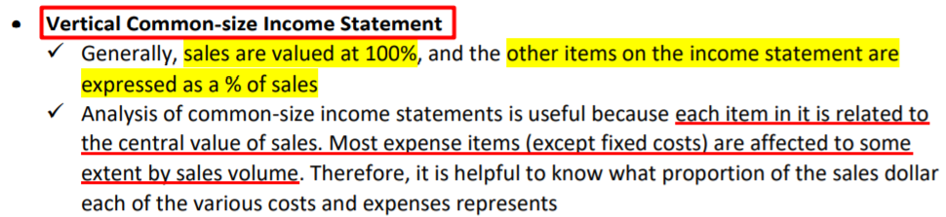
Vertical Common-Size Statements

Slide 63
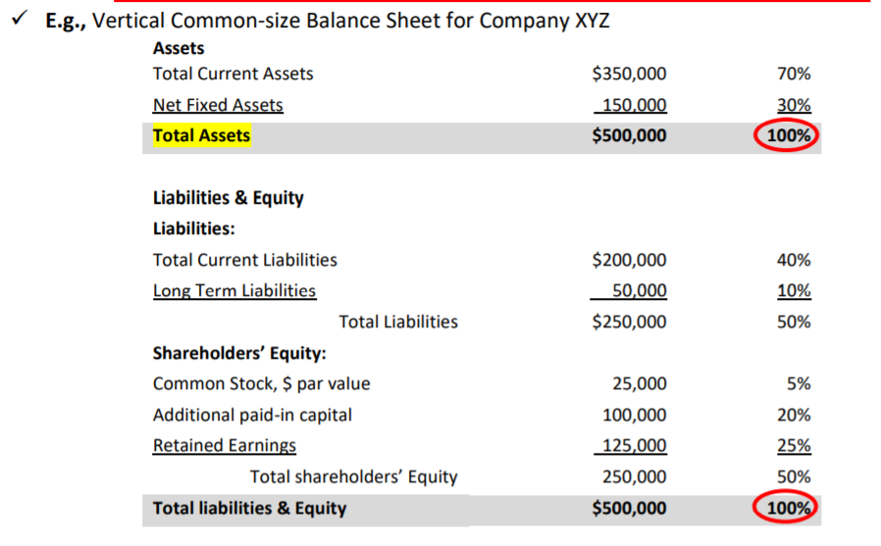
Example

Slide 64
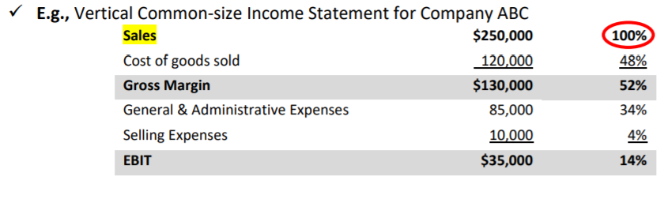
Example

Slide 65
Vertical Analysis
The management of HUL Company asks you to prepare a vertical analysis for the comparative balance sheets of the company.

Slide 66
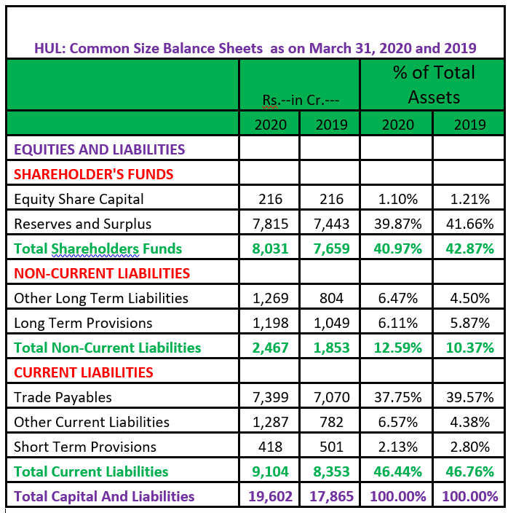
Vertical Analysis of Financial Position of HUL
Comment on—
Shareholder’s Funds
Long term debt
Current Liabilities
Trade payables.
=(216/19602)*100
=(216/17855)*100

Slide 67
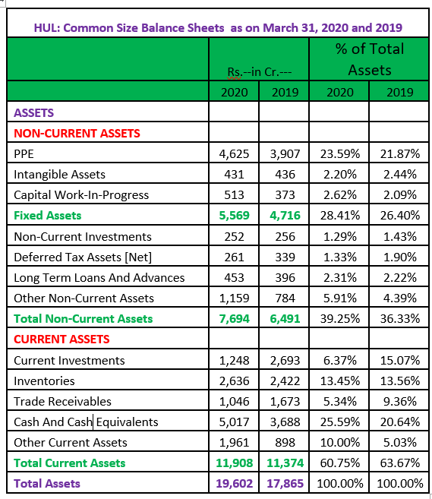
Vertical Analysis of Financial Position of HUL
Comment on—
Fixed Assets
Non Current Investments
Current Assets
Inventories
Trade receivables
Cash and Cash Equivalents

Slide 68
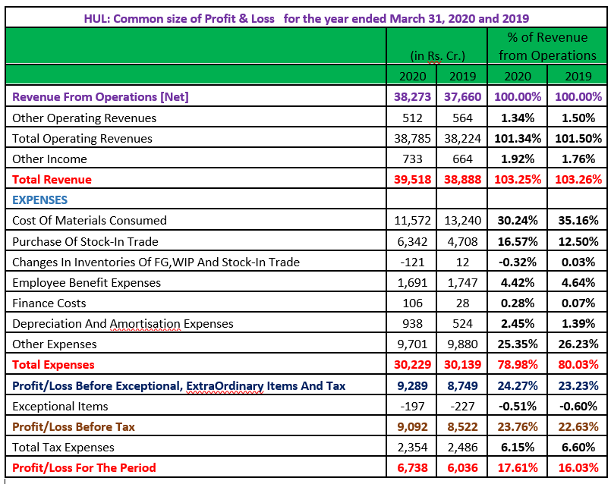
Vertical Analysis of Financial Performance of HUL
Comment on—
Total Expenses
Cost of Raw material consumed
Employee cost
Finance Cost
Depreciation
PBT
PAT
Overall profitability position of HUL

Slide 69
Other points to comment upon
Fixed Assets Utilisation
Operational Efficiency
Inventory Management
Creditors/Payment Management
Debtors/Collection Management
Financial Efficiency
Working Capital/Liquidity Management
Solvency Position
Leverage to know Financial Risk

Slide 70
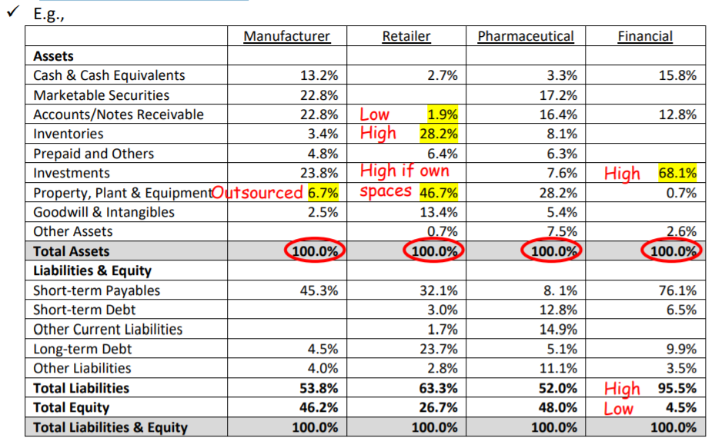
Vertical Common-Size Statement across Industries
Notes:
Typically, companies within the same industry display similar traits in their common sized statements, but companies in different industries display different traits

Slide 71
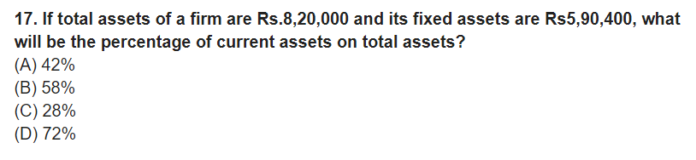
MCQ
Notes:
c

Slide 72
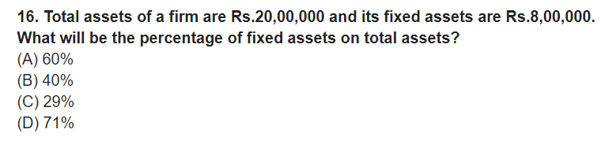
MCQ
Notes:
b

Slide 73
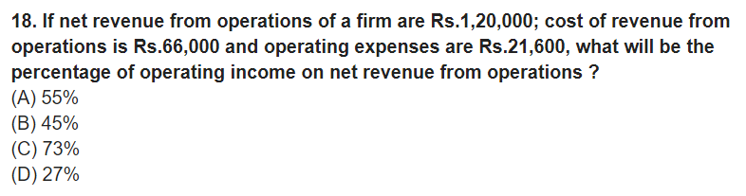
MCQ
Notes:
D is the answer (120000-66000-21600)/120000*100

